Slide 1

NATIVE PROGRAMMING
An Introduction to Unreal C++

Slide 2
PROGRAMMING
Introduction to C++ in UE4

Slide 3
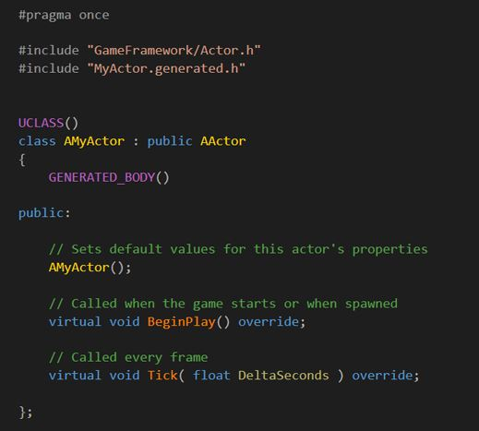

INTRODUCTION
While Unreal Engine has a C++ framework, the C++ programming is often referred to as “assisted C++” because of its range of features that make it easier to program in than traditional C++.
This presentation has been written with the assumption that you have some basic programming knowledge of C++. If you don’t but have some experience in C#, Java, or JavaScript, you’ll find many aspects similar.

Slide 4
C++ AND BLUEPRINTS
C++
Unreal Engine provides two methods for creating new gameplay elements, C++ and Blueprints.
Using C++, programmers add the base gameplay systems that designers can then build upon using Blueprint. This allows designers or artists to use the tools familiar to them to modify gameplay or to implement art without being reliant on a programmer.
Both methods are very flexible and can cover most use cases for developing systems; however, there are a few cases where one method presents advantages over the other.
Blueprint
Codebase
Editor
Gameplay

Slide 5
C++ AND BLUEPRINT—POINTS OF DIFFERENCE
Blueprint
C++
Blueprint is simple to use and get started with.
It enables anyone to implement gameplay behavior.
It has a short iteration time—very quick to compile and test inside the editor.
Art implementation is easy using the component editor.
While it can do a lot, its capabilities are limited to what programmers expose to it.
Debugging and development tools are much more mature and powerful in C++.
It is often simpler when multiple people are working on one file, as source control allows you to see differences.
Complex and mathematical operations can be easier to express in C++.
It is generally more performant than Blueprints.
Some parts of the engine are only accessible via C++.
Notes:
Blueprints are an extremely powerful tool for designers. They enable nearly anyone to be able to program gameplay behaviors without taking up engineer time, and they have a very short iteration time, allowing you to quickly create and tweak prototypes and features. Creating and tweaking visual effects is much easier and quicker and can allow artists to implement their own art in engine.
C++, while being more complicated, has a number of strengths. Native debugging tools are much more mature and powerful, making it easier to track down issues. Native source files are much more suitable for source control packages, giving you easy access to merge and diff tools that aren’t reliant on the Unreal Editor.
There are a few areas, such as mathematical operations, that are less verbose and easier to maintain natively than their Blueprint counterparts. There are also a number of areas of the code base that can only be accessed through the C++ API.
Both of these systems are powerful in their own right, but the Engine really shines when these methods are used in conjunction with each other, programmers creating gameplay building blocks in C++ and designers taking those blocks and making interesting gameplay.

Slide 6
CORE GAMEPLAY C++ BASE CLASSES
C++ MAIN CLASSES
There are four main class types that you derive from for the majority of gameplay classes. They are UObject, AActor, UActorComponent, and UStruct. New class types that do not derive from any of these classes can be developed or implemented, but they will not participate in the features that are built into the engine.
Typical uses of classes that are created outside of the UObject hierarchy often involve such things as integrating third-party libraries and wrapping of OS-specific features.
UObjects and AActors have basic memory management by default, including Garbage Collection.
UObject
AActor
UActorComponent
UStruct

Slide 7
UNREAL OBJECTS: UOBJECT
CORE FEATURES
The base building block in the Unreal Engine is called UObject. This class, coupled with UClass, provides a number of the most important base services in the engine:
Reflection of properties and methods
Serialization of properties
Garbage collection
Finding UObjects by name
Configurable values for properties
Networking support for properties and methods
Most gameplay development does not involve directly deriving from UObjects, but instead from AActor and UActorComponent.
Base class of all objects
Each class that derives from UObject has a singleton UClass created for it that contains all of the metadata about the class instance.

Slide 8
UNREAL OBJECTS: AACTOR
CORE FEATURES
An AActor is an object that is meant to be part of the interactive experience and is either placed in a level by a designer or created at runtime via gameplay systems. AActor derives from UObject and so features the functionality from the class. AActors can be explicitly destroyed via gameplay code (C++ or Blueprints) or via the standard garbage collection mechanism when the owning level is unloaded from memory.
AActors are responsible for the high-level behaviors of your game’s objects and are the base type that can be replicated during networking.
All AActors must have a root USceneComponent.
An object that is placeable in the world
Can be explicitly destroyed via gameplay code or via garbage collection
The base type that can be replicated during networking
Specialization through inheritance
Acts as component containers for a hierarchy
Before an AActor can be placed in a level, that AActor must contain at least a USceneComponent, which contains the translation, rotation, and scale for that AActor.

Slide 9
UNREAL OBJECTS:
UACTORCOMPONENT
CORE FEATURES
UActorComponents have their own behaviors and are usually responsible for functionality that is shared across many types of AActors.
While AActors are often given high-level goals related to their overall roles in your game, UActorComponents usually perform the individual tasks that support those higher-level objectives.
Uses of UActorComponents include the following:
Providing visual meshes
Particle effects
Camera perspectives
Physics interactions
Movement logic
Must be parented to an AActor
Child Components within an actor have location, rotation, and scaling relative to their parent Component or Actor.
A Component can only attach to one parent Component or Actor, but it may have many child Components attached to itself, forming a tree.

Slide 10
UNREAL OBJECTS:
USTRUCT
CORE FEATURES
A struct (also known as a data structure) is a collection of related data. Like classes, structs can contain functionality, which is typically restricted to the setting, getting, and processing of the data within the struct. A UStruct is Unreal’s specialized version of a C++ struct and is particularly useful at storing and moving around a collection of data.
Unlike UObjects and UActors, you do not have to extend from any particular class to use a UStruct. You just have to mark the struct with USTRUCT() and the Unreal Engine build tools will do the base work for you. Unlike a UObject, UStructs are not garbage collected. If you create dynamic instances of them, you must manage their life cycle yourself.
Does not require extending any class, but rather built into the macro system
Has UObject reflection support for editing within the Unreal Editor, Blueprint manipulation, serialization, networking, and so forth
Does not require explicit
Not garbage collected

Slide 11


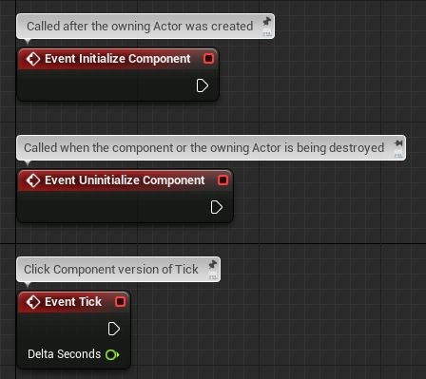
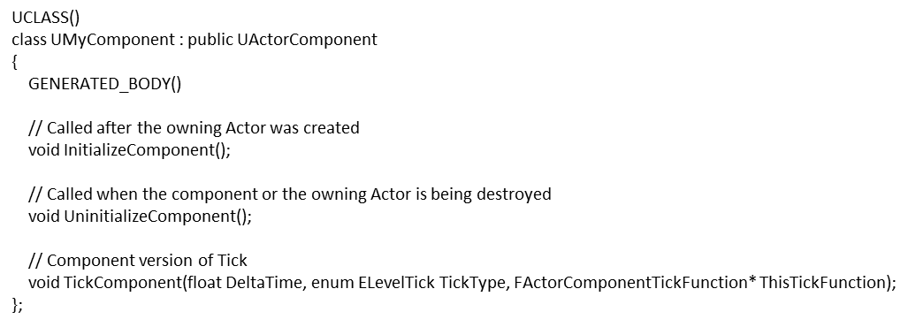
Blueprint
UE4 C++
Blueprint Events
C++ Equivalent
These are an example of some events that you may use inside of an Actor Component Blueprint.
Notice that the names of the events (InitializeComponent, UninitializeComponent and TickComponent) are similar to what you see in Blueprint.

Slide 12
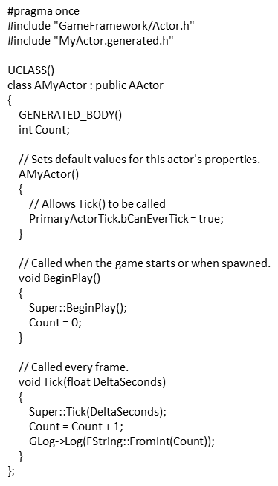
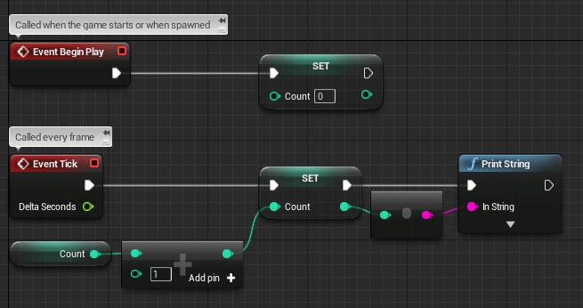
Blueprint
UE4 C++
Blueprint Functionality
C++ Functionality
This is a Blueprint example of incrementing a variable every tick and printing it to the screen. Note the use of BeginPlay and Tick.
This example shows how the same functionality would be implemented in C++. Note that incrementing “Count” by 1 happens in one line, compared to three nodes in Blueprint.

Slide 13
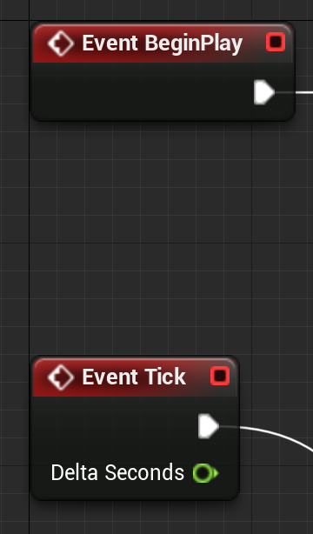
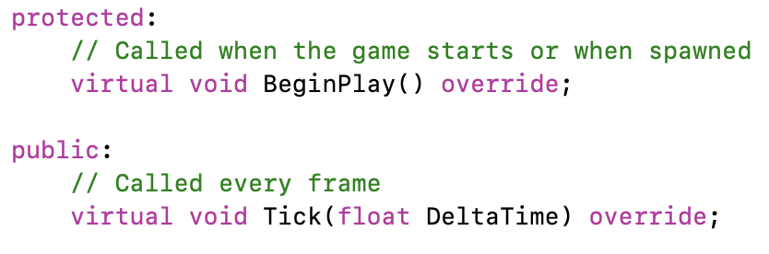
CORE BLUEPRINT EVENTS ⇔ C++ FUNCTIONS
The standard Blueprint Actor has event blocks so you can trigger something to happen on Actor Construction, Begin Play, or every game Tick.
The same options are available in C++ as virtual member functions OnConstruction, BeginPlay, and Tick.
When you create a new Actor class, it automatically creates templates for the BeginPlay and Tick functions, but you can add others. Look at the AActor base class and its parents to see what is available.
Overriding these virtual functions adds behavior for that Actor event.

Slide 14
Blueprint

Slide 15
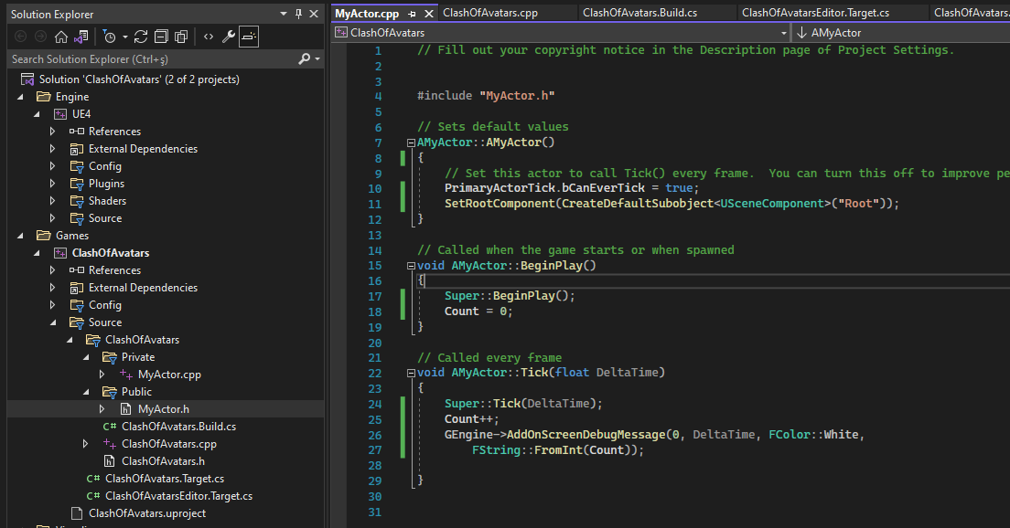

Slide 16
SOLUTION CONFIGURATIONS
UNREAL BUILD ENVIRONMENT
Debug Game: Game executable with debugging symbols.
Debug Game Editor: Editor dll with debugging help/symbols.
Development: Game executable with development features enabled, such as engine console and debugging screens and information.
Development Editor (default): Editor dll with development features. Normally used through development with the editor. Support hotspot reloading which plugs code changes to the blueprints on the fly. Still a buggy feature. Live coding also introduced as an experimental feature.
Shipping: Game executable stripped from debugging symbols and editor specific code, suitable to go with a shipped game.
C++ compilation is a very complex progress and driven with UnrealBuildTool:
<ProjectName>.Build.cs scripts are executed to resolve module dependencies.
Based on dependant modules and special engine specific macros additional cpp code is generated.
Your code should assume these generated modules are included by using:
#include «<ClassName>.generated.h»
lines at the end of all #include blocks int the header file.
Preprocessor is executed and all cpp modules are compiled.
What is produced at the linking step depends on project Solution Configuration.

Slide 17
ACTOR LIFE CYCLE

Slide 18
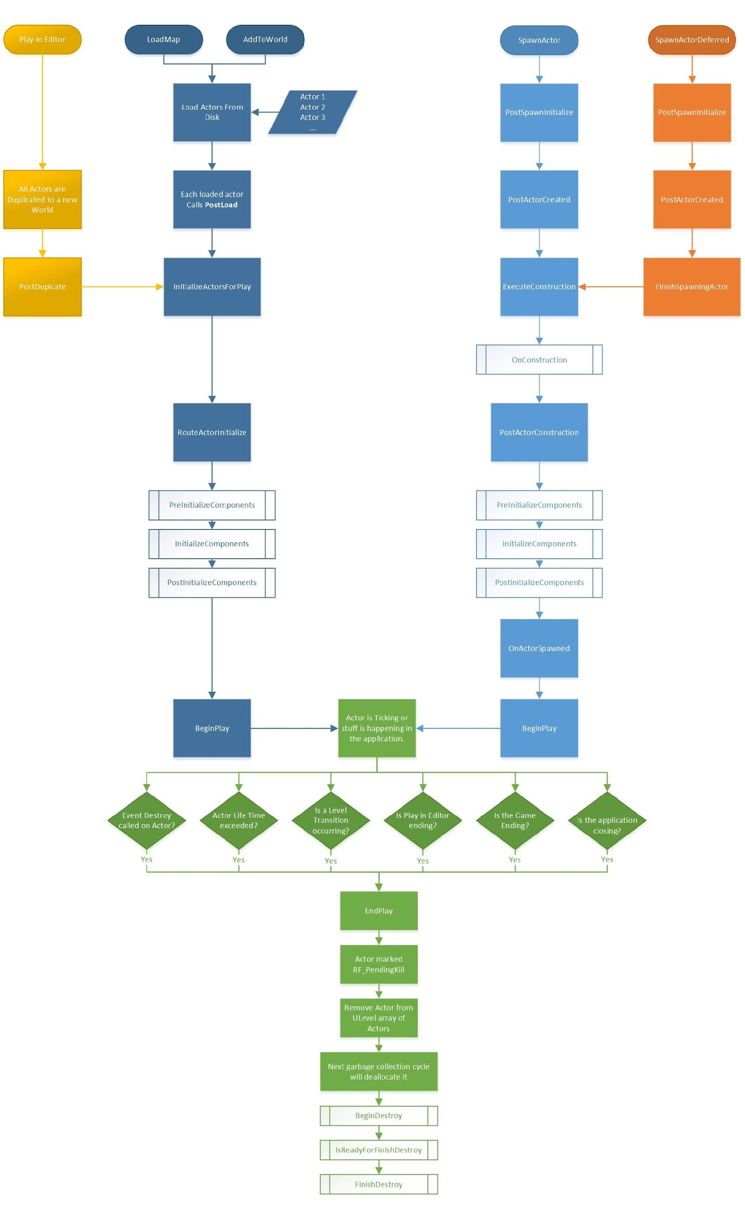

Slide 21
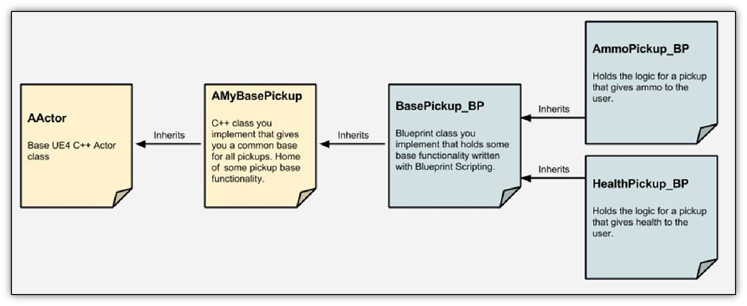
C++ AND BLUEPRINTS WORKING TOGETHER
When designing a class hierarchy, first you need to identify any common functionality and shared structure between groups of game elements.
These are typically placed in a base class, which can be extended to create the final game elements.
It is common practice to create the base classes in C++ as they often contain greater structural and functional complexity. The final functionality, customization, and art are added in Blueprint.
Sometimes an intermediate base class is added in Blueprint to allow designers and artists to contribute to the common functionality.
Example of C++ and Blueprint interaction

Slide 22
C++ AND BLUEPRINTS WORKING TOGETHER
Example of C++ and Blueprint interaction

Slide 23
Important Things to Consider When Deciding Whether to Build Functionality in C++ or Blueprint
Which team members are likely to modify the feature?
How complex is the feature?
Does Blueprint support the necessary functionality (for example, the Character Movement Component)?
How can this feature be broken down to ensure ease of customization and iteration?
How many people are likely to work on this feature simultaneously?

Slide 24
IDE SETUP
Installing Visual Studio 2022

Slide 25
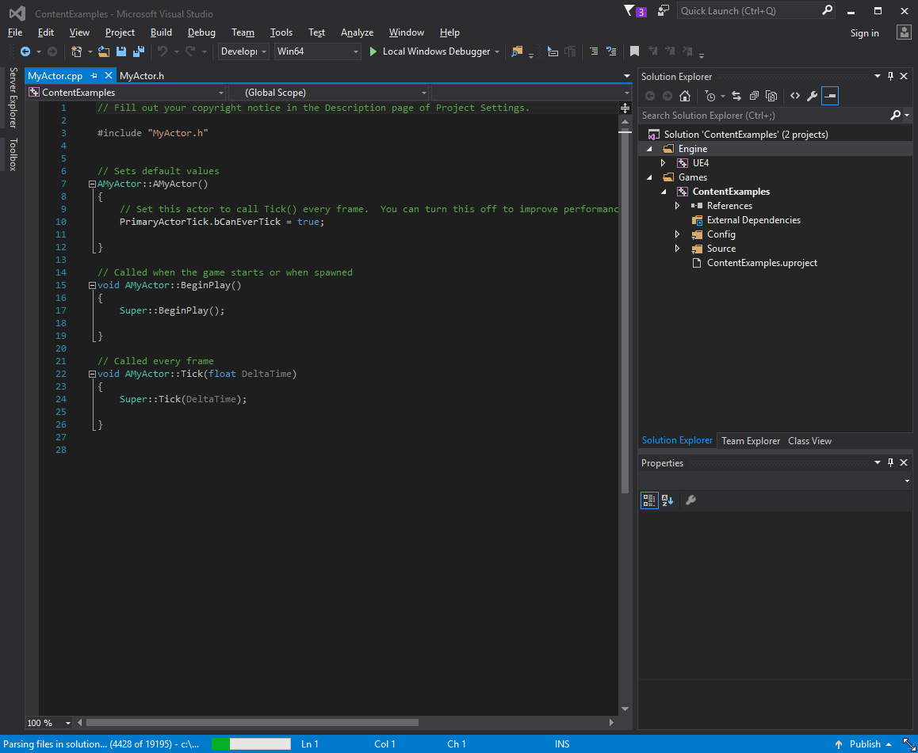
VISUAL STUDIO
If you want to start writing C++ code, you need to download and install Visual Studio.
Visual Studio is an integrated development environment (IDE) that allows you to write, compile, and debug code.
Visual Studio 2022 Community Edition is free to use for educational purposes and can be downloaded from www.visualstudio.com.
Notes:
Before we begin, we will need to install Visual Studio. We will be using Visual Studio to edit and compile our native code. Download the latest version of Visual Studio Community Edition and run the installer. It’s important to note that Visual Studio does not install C++ tooling support by default, so you will have to choose Custom installation and then choose the C++ components that you’ll need for your workflow.

Slide 26
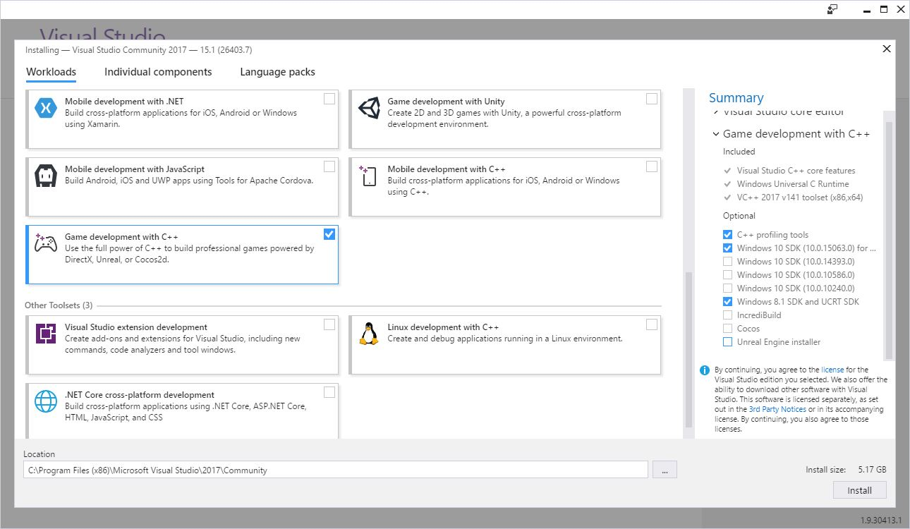
INSTALLING VS2022
Once you install Visual Studio 2022, you need to ensure you select the correct Workload.
Find “Game development with C++” and ensure that it is selected.
Workload selection in VS2017

Slide 27
C++ PROJECT
Creating Your First C++ Project

Slide 28
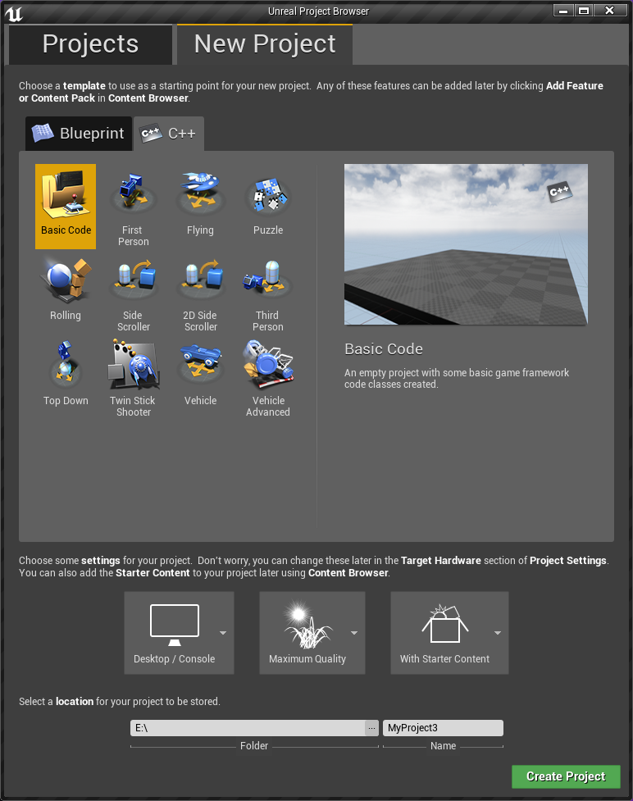
CREATING NEW PROJECT
You can create a brand-new UE4 project based off one of the provided templates. However, when selecting the template, make sure to choose the C++ tab so the basic structure is set up for you automatically.
Once this project is set up, the easiest way to add new native classes to your project is via the Class Wizard in the Unreal Engine Editor, which can be accessed via File > Add New C++ Class.
As for this course’s implementation start with:
Blueprint
Thirdperson Template

Slide 29
CONVERTING A BLUEPRINT PROJECT TO C++
If you start a project using Blueprint and decide later to do some C++, it is possible to switch it over.
In the Content Browser, create a new C++ class (e.g., a new C++ Actor class for Actor behavior).
After UE4 is done generating the files, quit the engine and then run the GenerateProjectFiles script.
When you relaunch the project, it’ll be a full-fledged C++ project.
You can identify code projects because they will have a Compile button in the toolbar.

Slide 30
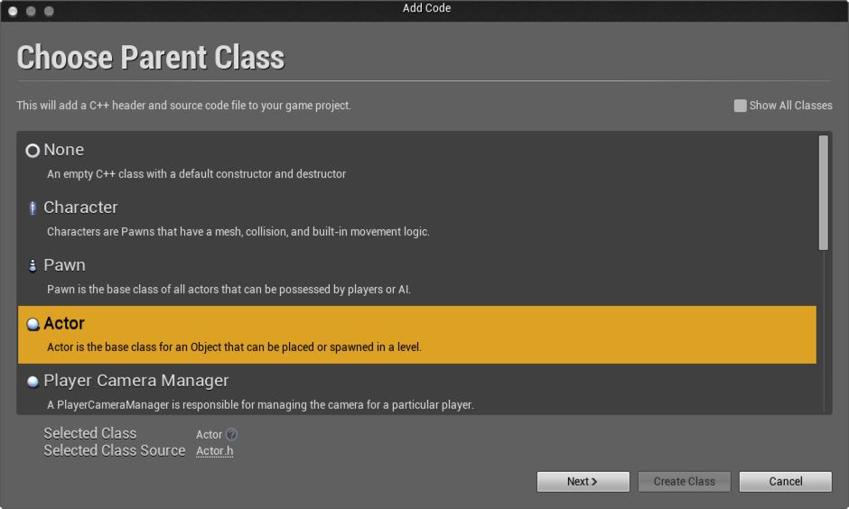
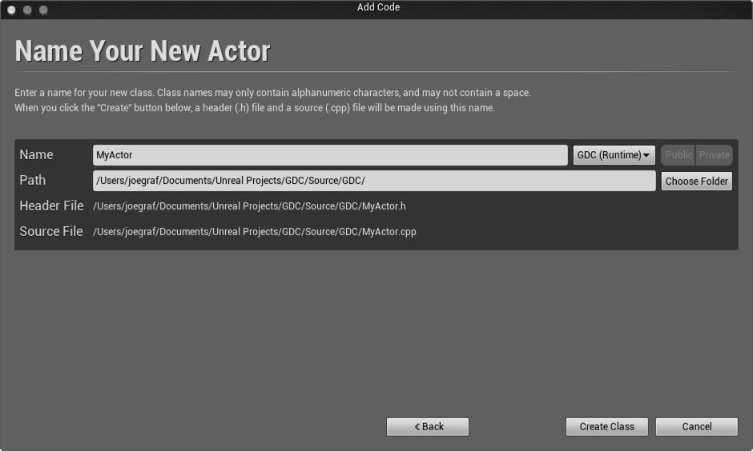
Choose Parent Class menu
Name Your New Actor menu
Creating Parent Class
Naming Your Class
The Choose Parent Class menu presents a list of common classes you might want to create. To see more, check “Show All Classes” in the top right corner.
The Name Your New Actor menu allows you to choose a name for the class that you’re creating. The name should be easy to read, but not too long. In this case, call it MyActor.
Notes:
There are two easy steps involved in creating a new class with the Class Wizard. First select the class you would like to subclass. Initially you are presented with a list of the more popular classes that people would want to be subclassing, but you can see a full list by toggling the “Show All Classes” checkbox in the top right corner.
After you have chosen the class you want to subclass, the only other thing you need to do is to name your class. When you are finished, click the “Create Class” button and the Class Wizard will generate header and source files, open them in Visual Studio ready to be edited, and, by default, compile your new class.

Slide 31
DESIGNING C++ CHARACTER CLASSES AND BLUEPRINTS
C++
Blueprints
What are the most basic character functions?
Healing
Being dead / Damage System
Following Camera
Stamina / Running
Health Bars
How many actor types are necessary and can be derived from each other?
NPCs
Enemies
Avatars
Which functionalities / properties the designer should access?
Character Skeletal Meshes
Character Animations
Healing Rate
Max Health
Running Speed
Max Stamina

Slide 32
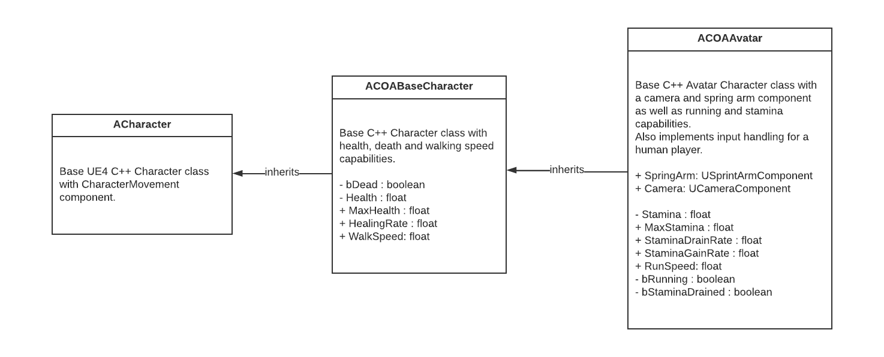
PROJECT: CLASH OF AVATARS (COA)
C++ CLASSES

Slide 33
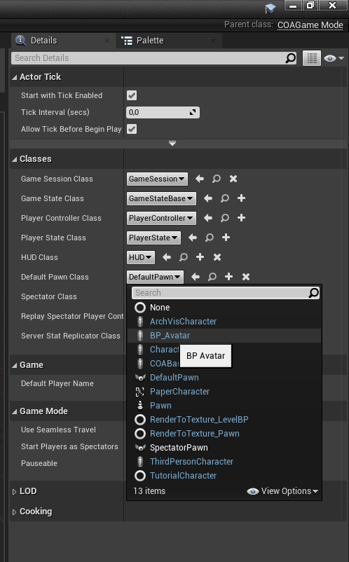
PROJECT: CLASH OF AVATARS (COA)
Implementation Steps #1
Our project’s short code prefix is COA.
Add «Public» COABaseCharacter class drived from Character.
Add «Public» COAGameMode class drived from GameModeBase.
Create Blueprints folder under Content root.
Add BP_Avatar blueprint derived from COABaseCharacter at Blueprints Folder.
Add BP_COAGameMode blueprint derived from COABaseCharacter at Blueprints Folder. (Use All Class section from Pick a parent class menu.)
Edit BP_COAGameMode as the default Pawn Class to be BP_Avatar. (Use All Class section from Pick a parent class menu.)
Set BP_COAGameMode as the project’s default gamemode class from Blueprint toolbar button.
Delete ThirdPersonCharacter actor from world outliner to prevent it becoming main player.

Slide 34
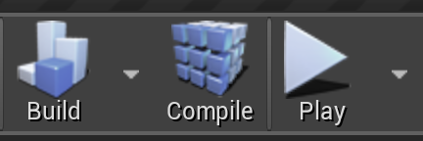
RECOMPILING CODE
You can recompile Actor or component code when you make changes without having to exit the Editor. Just press the Compile button in the main toolbar.
The changed code will be recompiled and reloaded into your running Editor.
To manage the hot reload, UE4 saves the class data with the old class, then loads it with the new. If class data changes significantly, you may need to delete the Actor from the scene and read it, but most changes will just work.

Slide 35
#include "MyObject.generated.h"
UCLASS(Blueprintable)
class UMyObject : public UObject
{
GENERATED_BODY()
public:
MyUObject();
UPROPERTY(BlueprintReadOnly, EditAnywhere)
float ExampleProperty;
UFUNCTION(BlueprintCallable)
void ExampleFunction();
};
BLUEPRINT FROM C++
The UCLASS, UPROPERTY, and UFUNCTION markups in this example include additional specifiers. These are not required, but some common specifiers have been added for demonstration purposes. These allow us to specify certain behaviors or properties.
Blueprintable: This class can be extended by a Blueprint.
BlueprintReadOnly: This property can be read from a Blueprint, but not written to.
Category: This defines what section this property appears under in the Details view of the Editor. This is helpful for organizational purposes.
BlueprintCallable: This function can be called from Blueprints.

Slide 36
UNREAL C++ SUPPLEMENTATION
Class Naming Prefixes
Reflection Macros
Classes derived from Actor are prefixed with A (e.g., AController).
Classes derived from Object are prefixed with U (e.g., UComponent).
Enums are prefixed with E (e.g., EFortificationType).
Interface classes are usually prefixed with I (e.g., IAbilitySystemInterface).
Template classes are prefixed with T (e.g., TArray).
Classes derived from SWidget (Slate UI) are prefixed with S (e.g., SButton).
Everything else is prefixed with the letter F (e.g., FVector).
UCLASS(): Used to tell Unreal to generate reflection data for a class. The class must derive from UObject.
USTRUCT(): Used to tell Unreal to generate reflection data for a struct.
GENERATED_BODY(): Replaced in UE4 with all the necessary boilerplate code that gets generated for the type.
UPROPERTY(): Enables a member variable of a UCLASS or a USTRUCT to be used as a UPROPERTY.
UFUNCTION(): Enables a class method of a UCLASS or a USTRUCT to be used as a UFUNCTION.
UENUM(): Used to tell Unreal to generate reflection data for an enum.

Slide 37
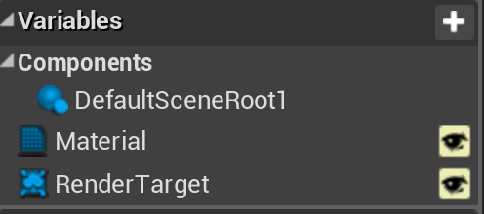
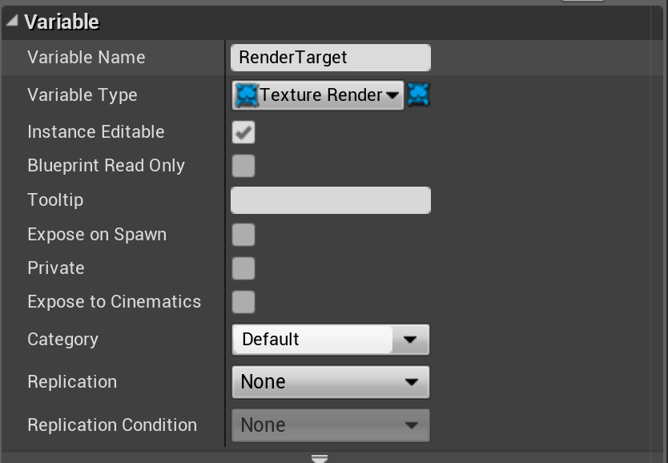
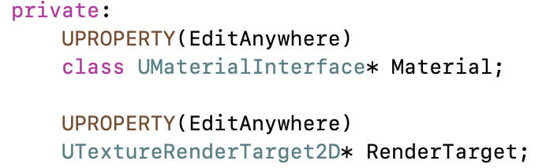
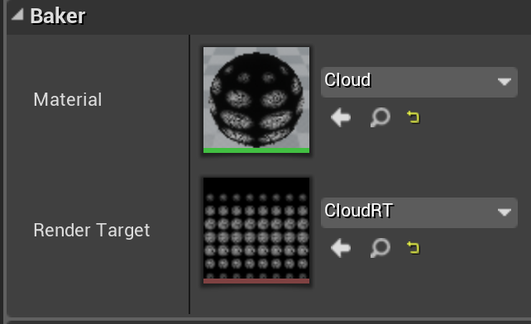
BLUEPRINT VARIABLES ⇔ C++ MEMBER DATA
In Blueprint, you can create variables associated with your Actor. Values for these are saved with the Actor. These can be set to be either visible in the Actor’s Details window, or internal and hidden.
In C++, any member variable preceded by the UPROPERTY() macro will be saved with the Actor, but hidden. Variables without UPROPERTY() can hold temporary data, but will not be saved.
A member variable preceded by “UPROPERTY(EditAnywhere)” will be visible and changeable in the Editor Details window.
Default values for variables are set in the class constructor, though be aware that the constructor is not run when restoring from a save.

Slide 38
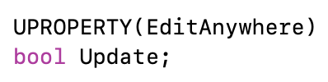
UPROPERTY MAGIC
The UPROPERTY macros are parsed by the Unreal build process to generate user interface and serialization (saving and loading) code.
Comments before the UPROPERTY will show up as a pop-up tooltip.
Arguments to UPROPERTY can control many aspects of how it will appear, including changing the displayed name, setting min and max slider bounds, or setting a hard min and max value for the UI (code can still create out-of-range values).
See online documentation for all of the options.

Slide 39
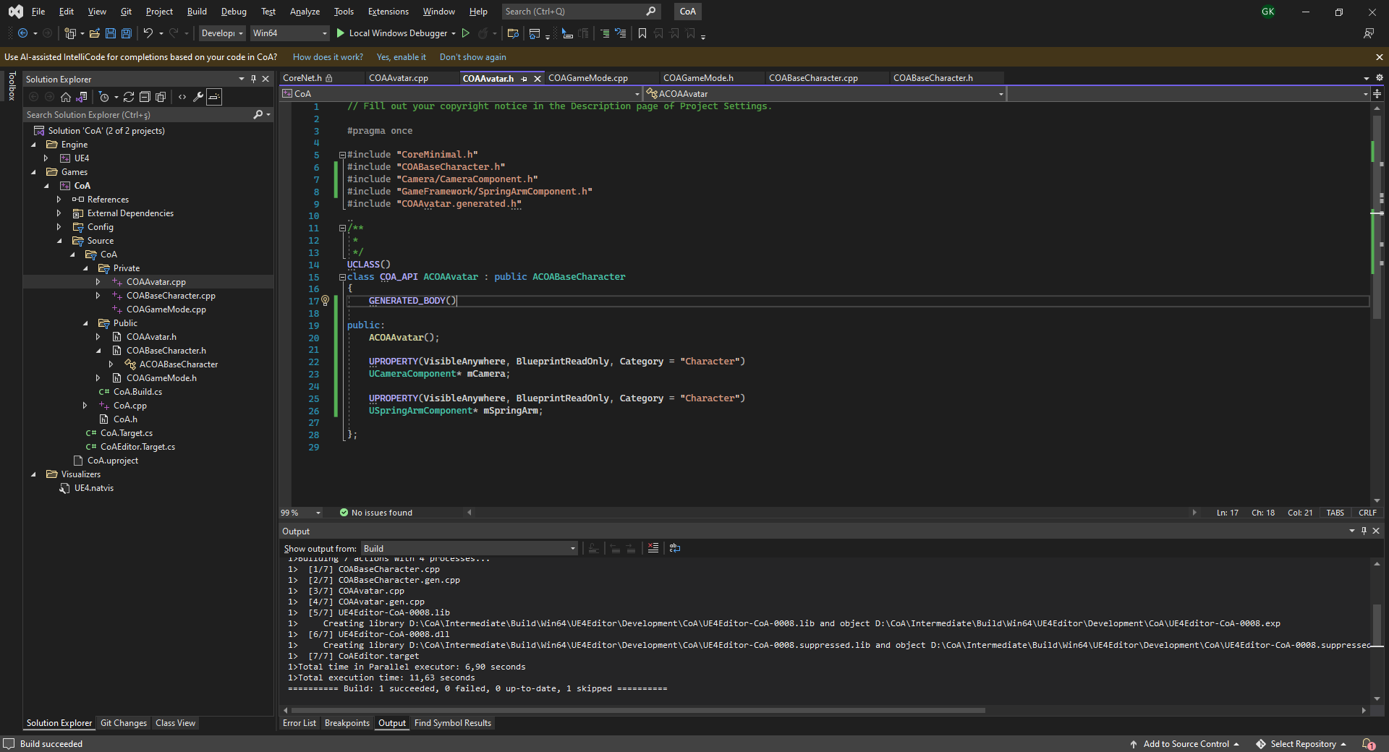
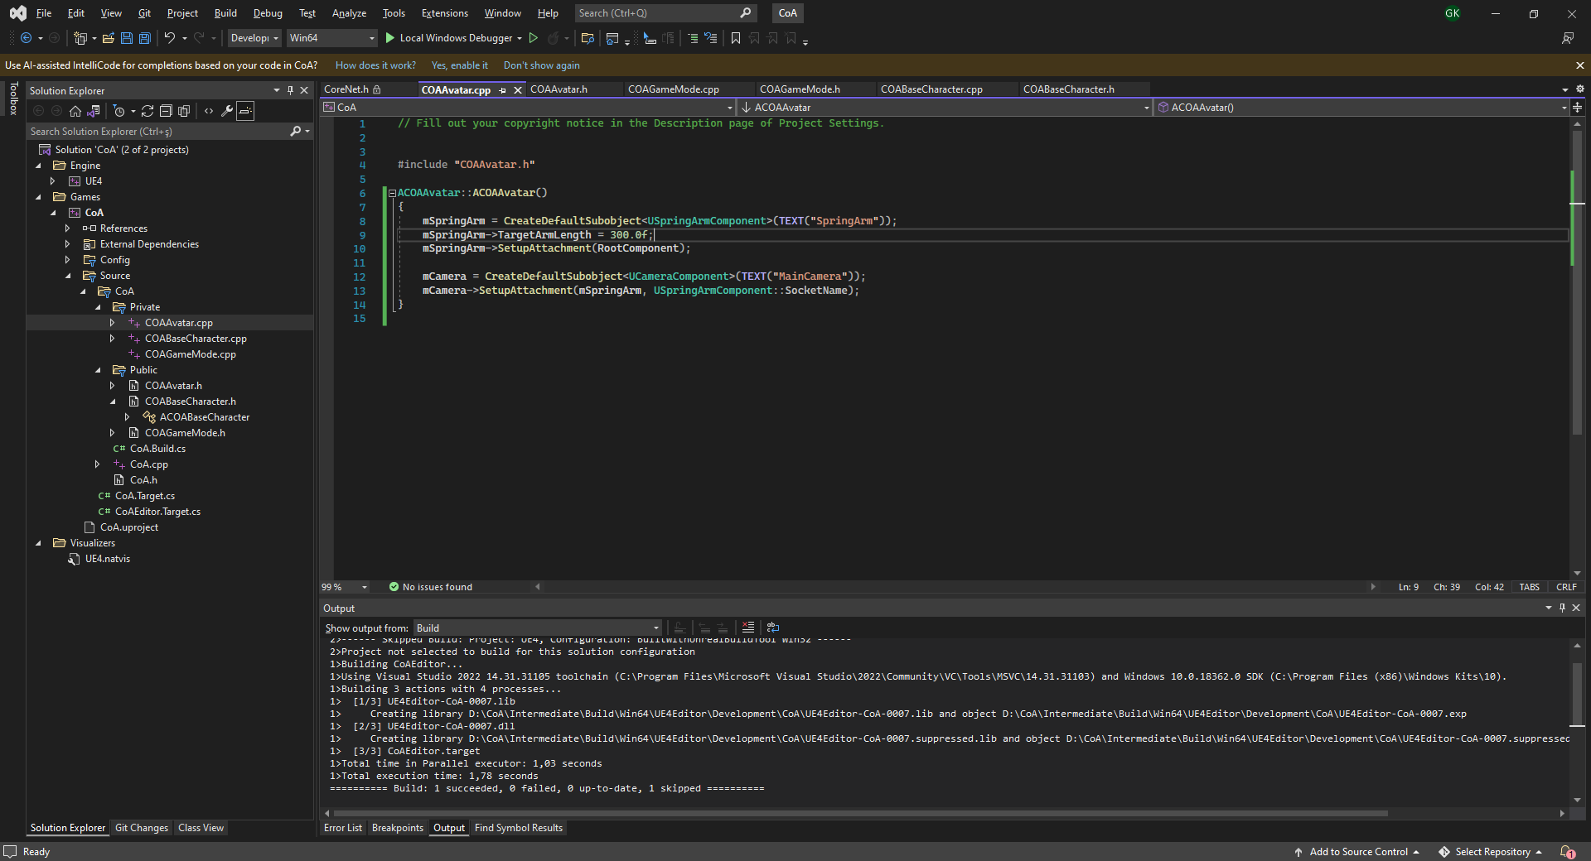
CAMERA AND SPRINGARM
Implementation Steps #2
Add New C++ Class and pick show all classes and derive from COABaseCharacter. Name it to COAAvatar.
Reparent BP_Avatar by going Class Settings and picking Parent Class as COAAvatar.
Add a USpringArmComponent and UCameraComponent to COAAvatar.cpp.
Close editor and compile the code and restart if changes weren’t reflected to BP_Avatar.

Slide 40
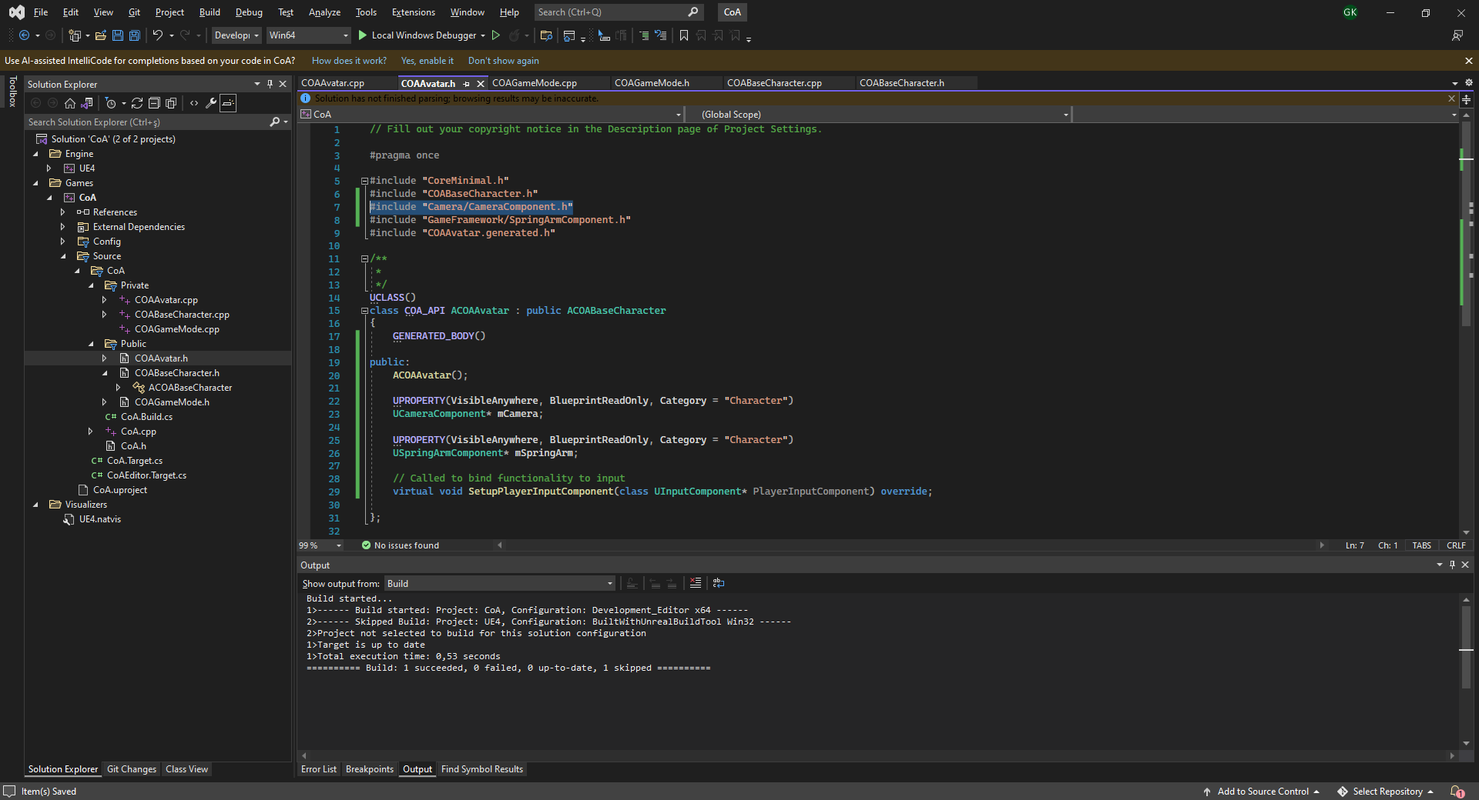
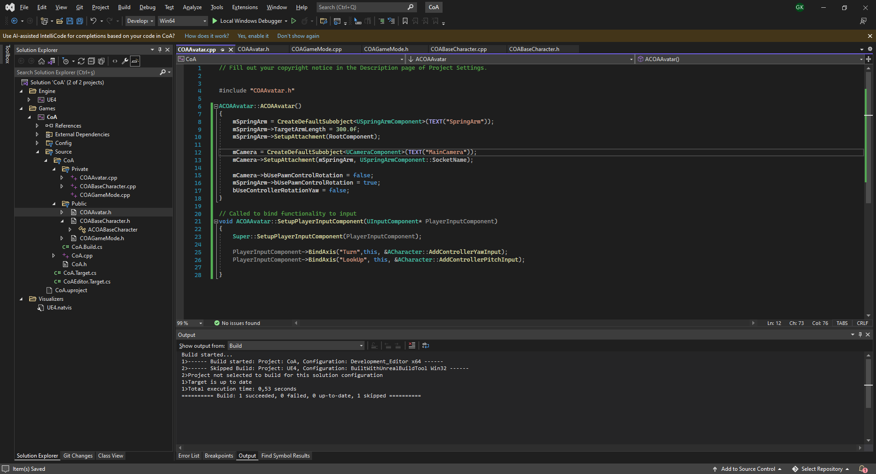
TURN AND LOOKUP INPUTS
Implementation Steps #3
Move SetupPlayerInputComponent() method definitions from COABaseCharacter.h to COAAvatar.h and .cpp source files.
Also move #include "Camera/CameraComponent.h«
Add Axis bindings for «Turn» and «LookUp» events using PlayerInputComponent->BindAxis()
Set use of controller axis rotation only limited to Spring Arm component by setting bUsePawnControlRotation = true;
Set Camera and Pawn controllerrotation copying settings to false;

Slide 41
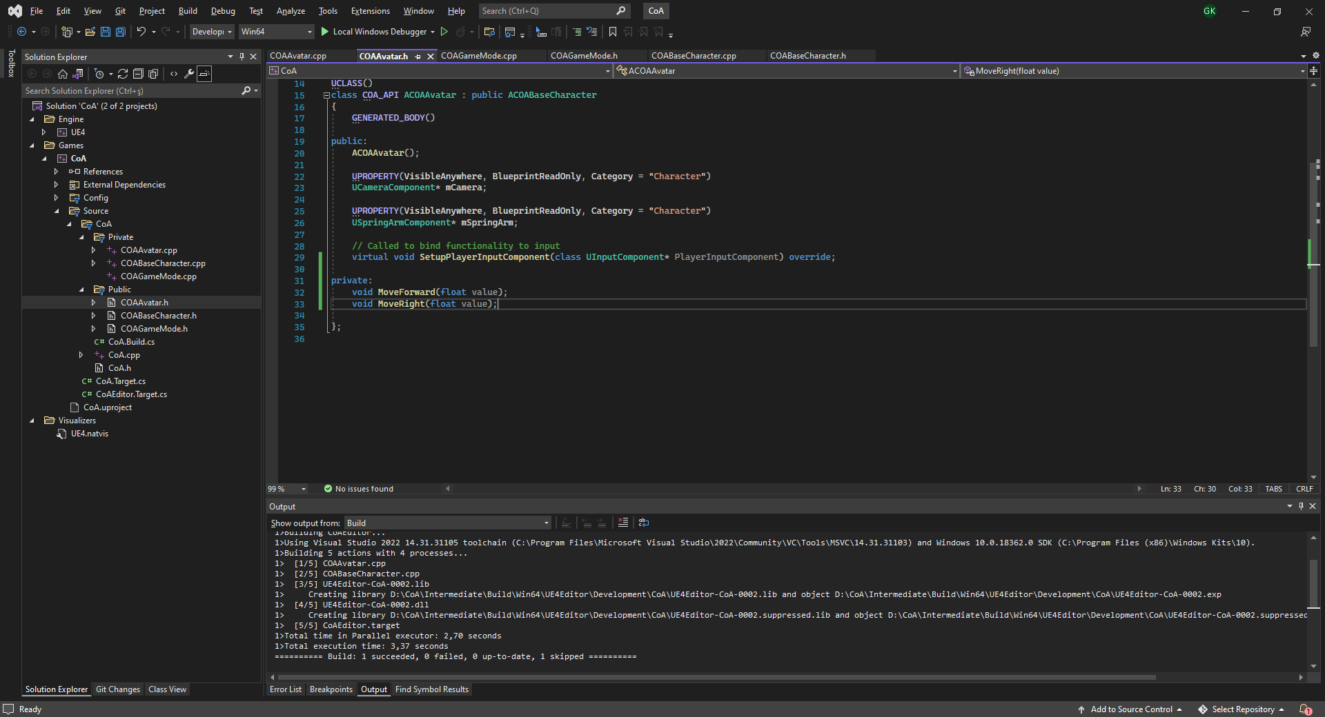
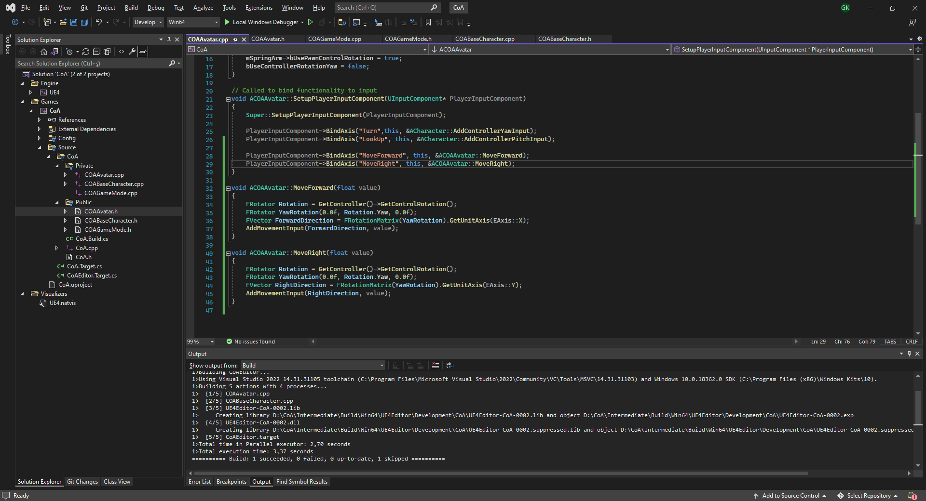
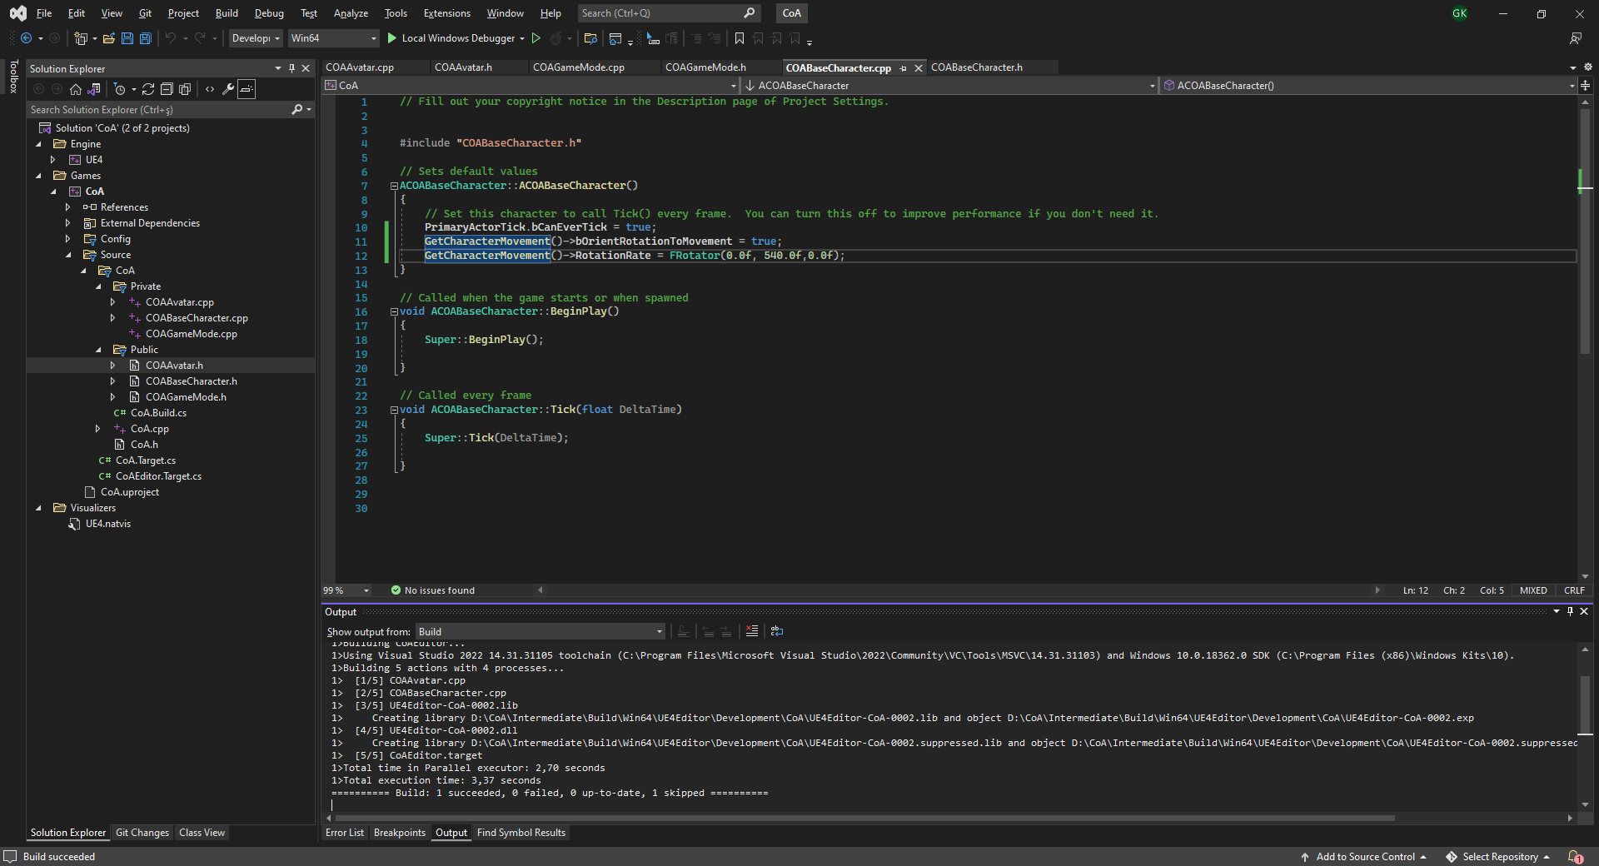
MOVEMENT INPUT
Implementation Steps #4 (Movement)
Create private MoveForward() and MoveRight() methods in ACOAAvatar class.
BindAxis() for «MoveForward» and «MoveRight» events with these function.
Implement movement direction calculation in these methods using GetConroller()->GetControllerRotation() and FRotationMatrix() class.
Make charactermovementcomponent to ortient the direction of the player to the movement direction by implementing it in ctor of ACOABaseCharacter(). Since this could be common for all game’s characters’ movement.

Slide 42
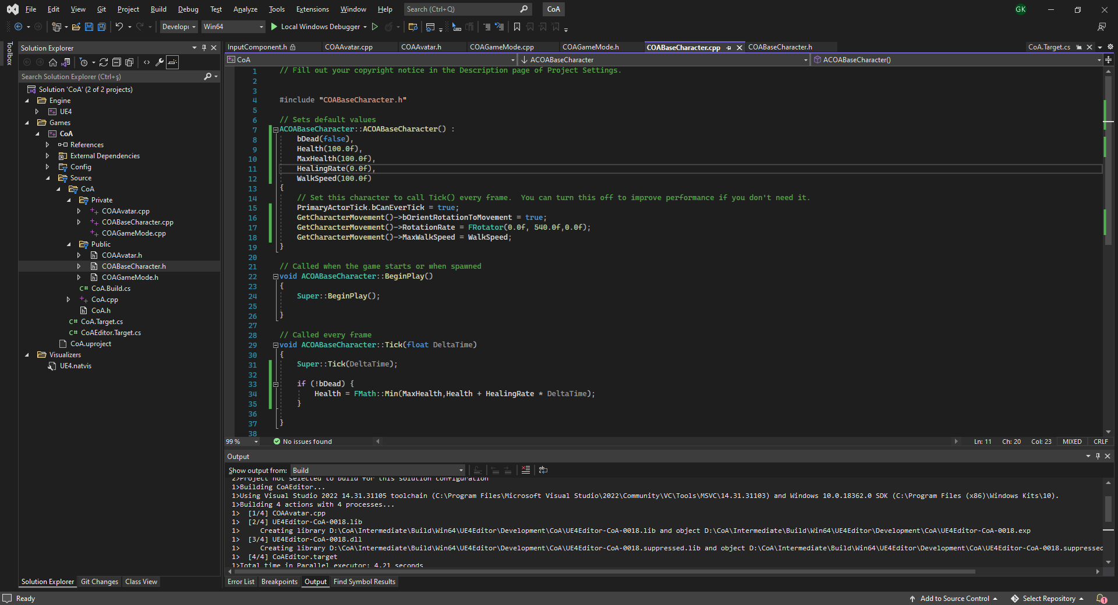
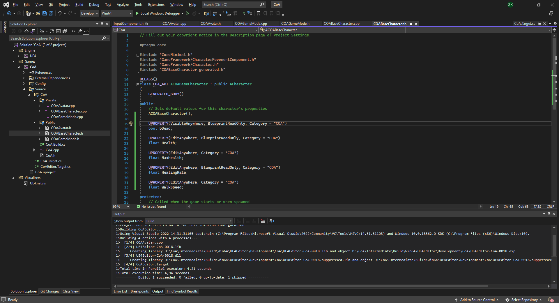
WALKSPEED AND HITPOINTS
Implementation Steps #5
Add these properties: bDead, Health, MaxHealth,HealingRate,Walkspeed on ACOABaseCharacter.h.

Slide 43
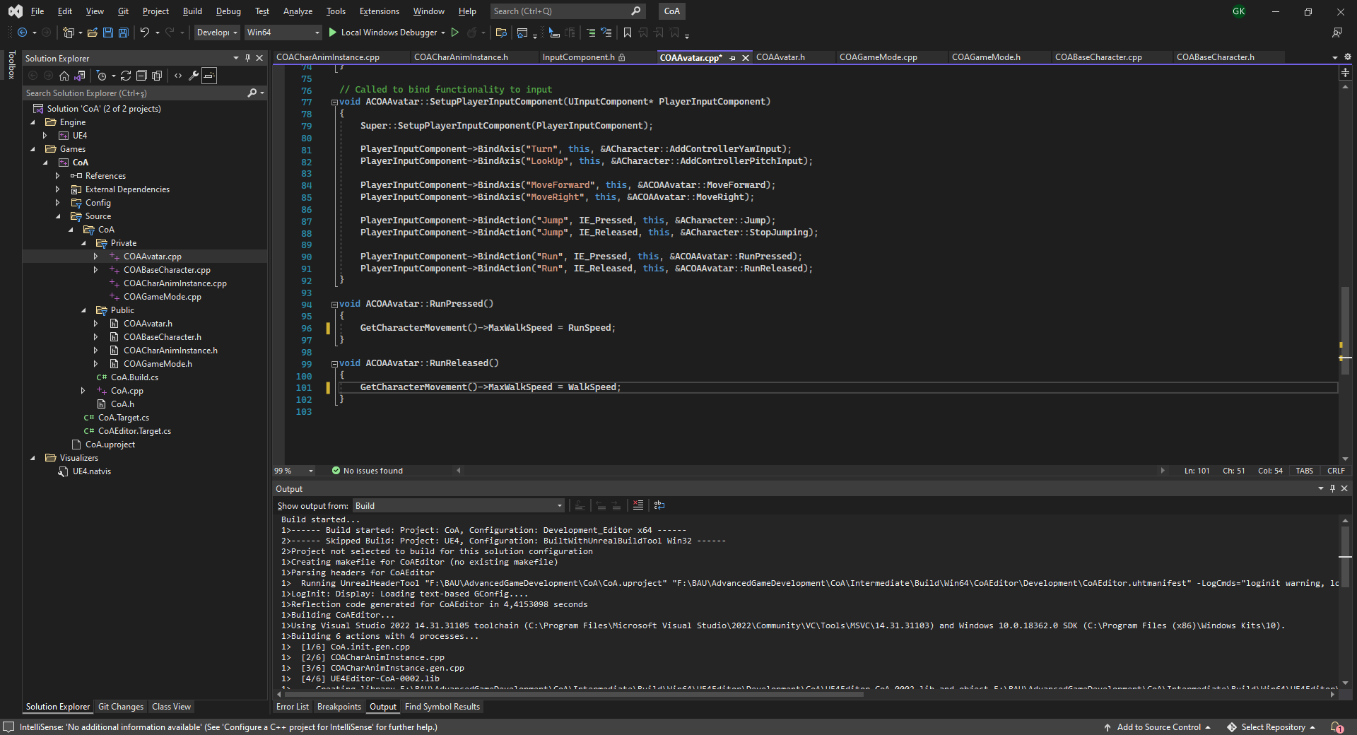
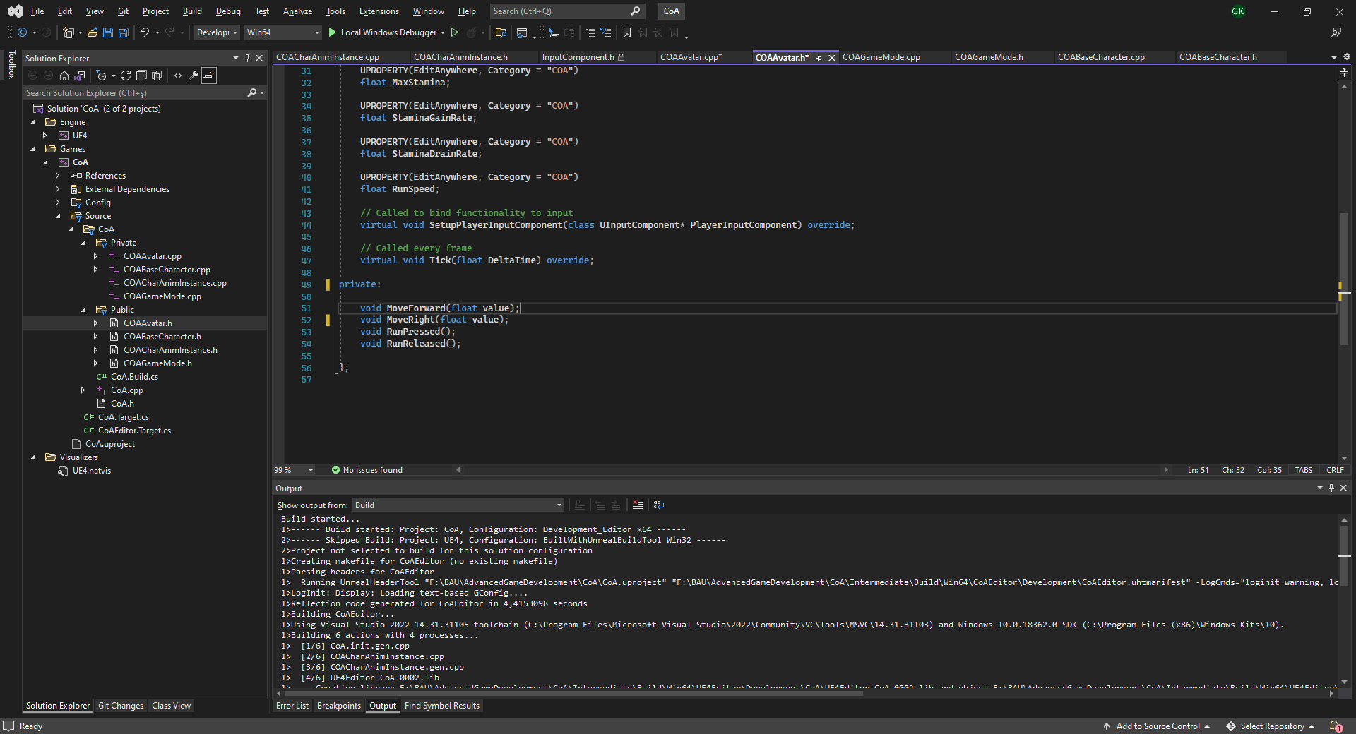
RUNNING
Implementation Steps #6
Add RunSpeed property to COAAvatar.h and set a default value.
Add «Run» action bindings at project settings and assign it to Left Shift.
Implement RunPressed() and RunReleased() methods and bind them to Run key event.

Slide 44
PROPERTIES TO ADD:
Stamina
MaxStamina
StaminaGainRate
StaminaDrainRate
RunSpeed
bStaminaDrained
bRunning
METHODS TO IMPLEMENT:
UpdateMovementParams() :
Sets the correct movement speed based on stamina state.
RunPressed()
RunReleased():
Edit these based on the new implementation.
StaminaGainRate
StaminaDrainRate
RunSpeed
bStaminaDrained
Tick():
Update stamina here.
Use this code to check if player is in walking state:
GetCharacterMovement()->MovementMode == EMovementMode::MOVE_Walking
LABWORK:
STAMINA SYSTEM
Implement a stamina system at ACOAAvatar class as explained below:
Player starts at MaxStamina. (=100)
As they walk stamina get drained StaminaDrainRate per second.
As they don’t walk stramina gets increased StaminaGainRate per second.
When Stamina reaches zero player enters into StaminaDrained state and a flag becomes true.
Player has to stay in walking speed till the Stamina reached MaxStamina. After that, the flag becomes false.

Slide 45
CONCLUSION
Questions?

